Slide 1



Welcome To 23MXians

Slide 2

What’s About to
Come?
How to prepare yourself!

Slide 3
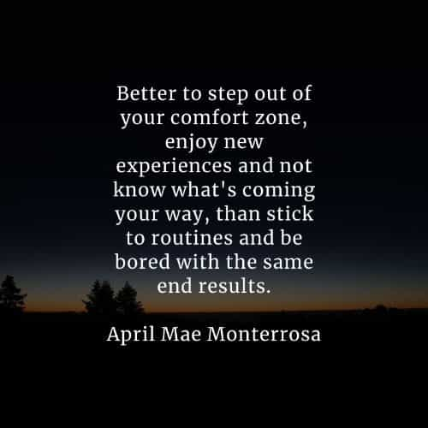
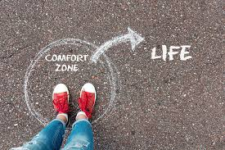
Pre-KG
College
Industry
Oversea Assignment
Changing the Work Environment
Friends Circle

Slide 4
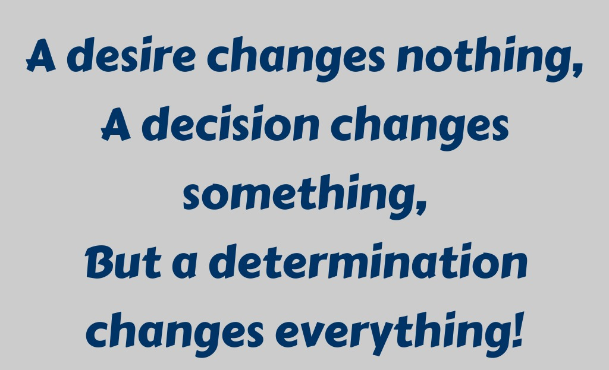

Slide 5

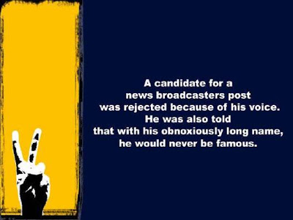
Main Pre-requisite – Avoid Opinion influencing

Slide 6
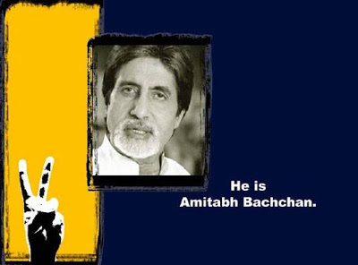

Slide 7
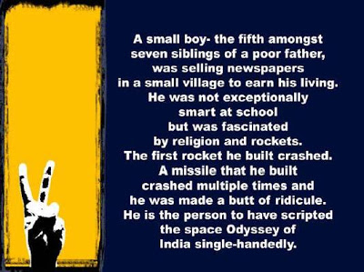

Slide 8


Slide 9
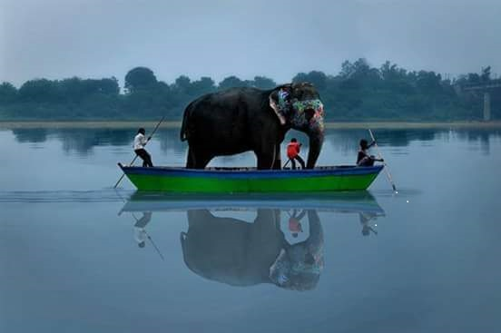
Lessons learned from this picture
Confidence and Self-assurance

Slide 10
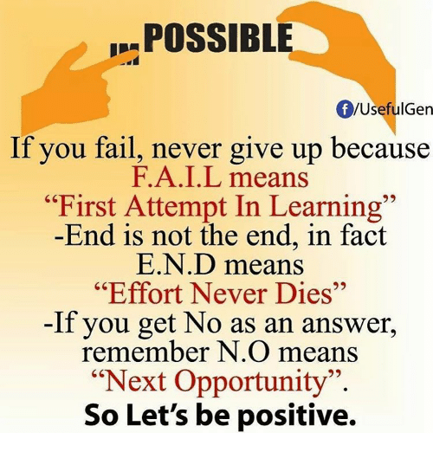

Slide 11
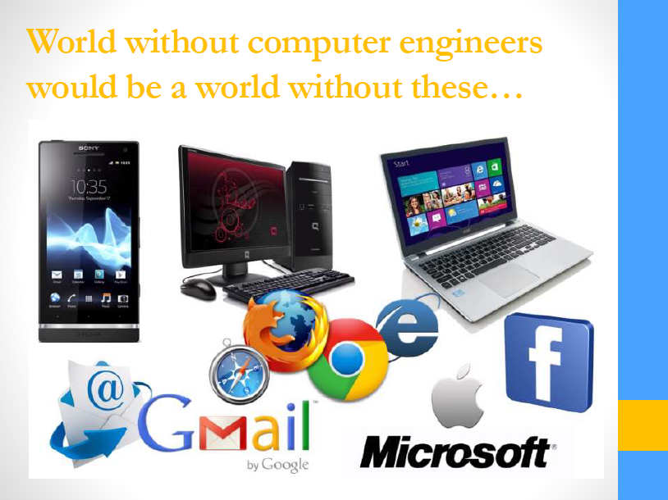

Slide 12
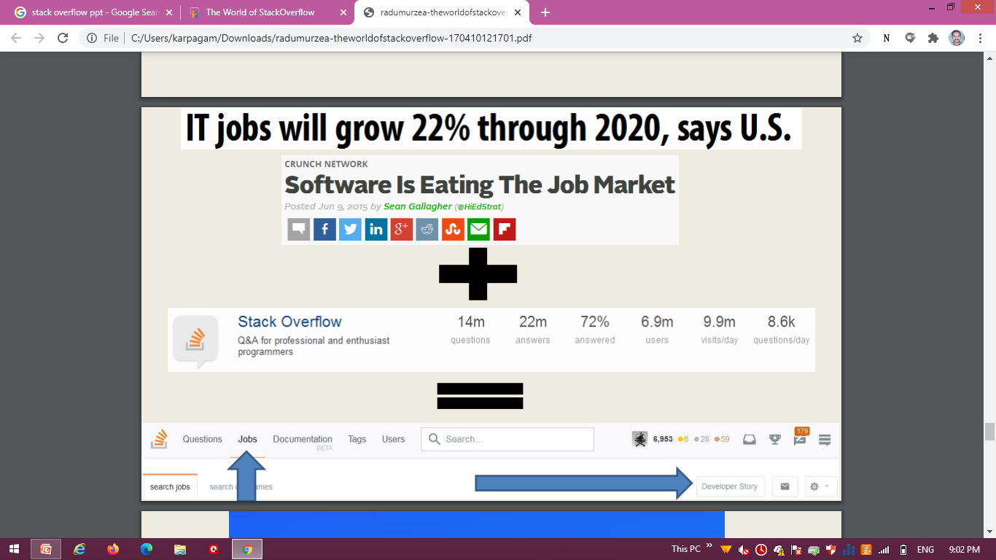
According to the Indeed India Hiring Tracker, that maps quarterly job market activity to June 2021, hiring increased by 11% over the previous quarter, with standout growth in Information Technology (61%), financial services (48%), and BPO/ITeS (47%).

Slide 13
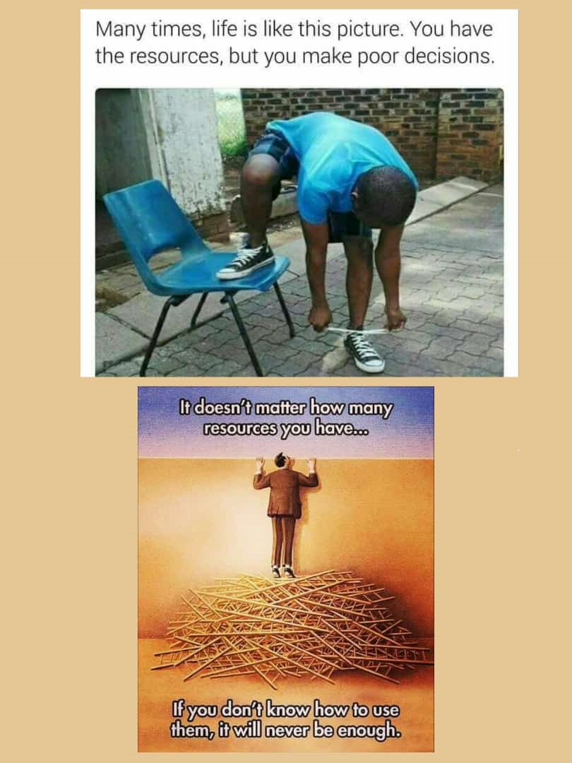
Poor Decision ?!!

Slide 14
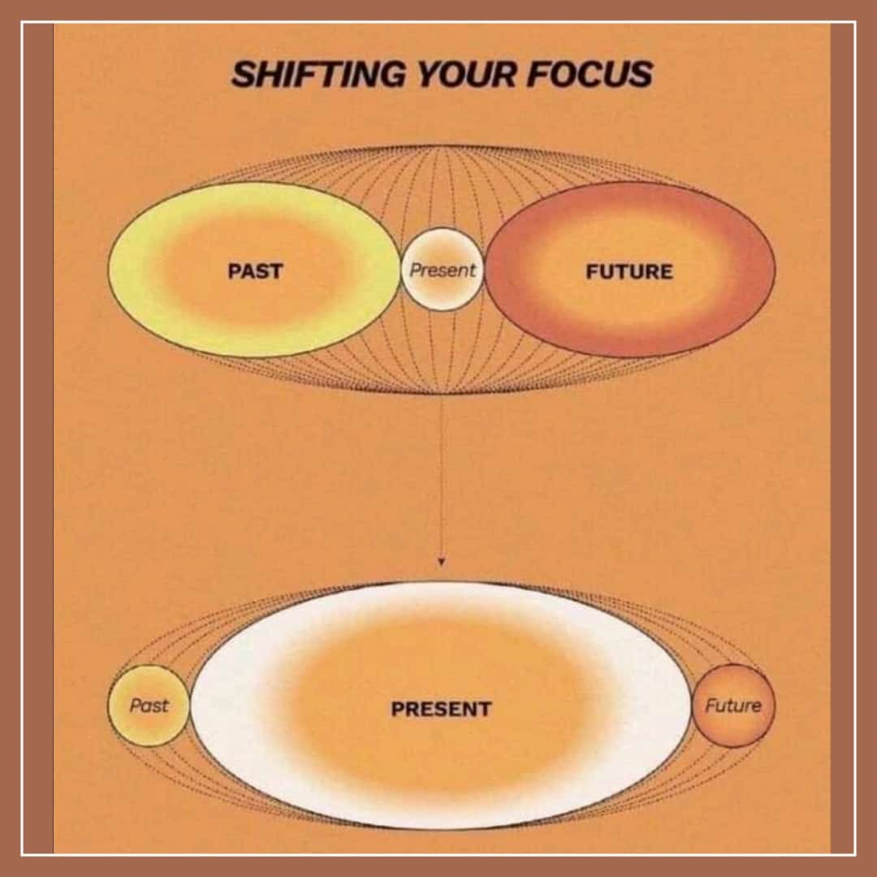

Decision Number 0

Slide 15


Decision Number 1

Slide 16
“Time is what we want most, but what we use worst”
Decision Number 2

Slide 17


TIME MANAGEMENT
Self-Management
86,400 Seconds
1,440 Minutes
24 Hours
Evaluate
Prioritize
Organize
Notes:
Everyone has the same amount of time available each day - 24 hours, 1,440 minutes, and 86,400 seconds. All these are constant.
There are 168 hours in every week.
How are you spending yours?
Self management is a process of evaluation, prioritizing and organizing one's tasks.
An individual who cannot manage his time effectively, who lacks a clear perception of available time, and who fails to monitor his own use of time will likely fail to accomplish tasks in a timely manner. Such failure generally leads to poor job performance and limited productivity.
Why care about time management?
The main reason is that time management benefits you.
“Why should I manage my time?”
The simple answer is that time management helps you stay on top of your tasks and get more done.
Yet, there is much more.
Time management benefits you in all areas of your life.
Time management is all about spending your time in the right places, and on the right things.
It’s about knowing your priorities, obligations, and schedule.
When you manage your time, you benefit in all areas of life.
You don’t manage time. You manage yourself, others, and your work.

Slide 18
LIFE
Sleep ( 8 hrs) : 22 yrs
Daily routine (1 hr) : 2.5 yrs
Meals (2-1/4 hrs) : 5.5 yrs
Travel (3 hrs) : 6 yrs
Work (7 hrs) : 15 yrs
Miscellaneous (1 hr) : 2.5 yrs
Personal discretion (17%) : 11 yrs
-----
65 yrs
Global average life span = 65 yrs

Slide 19




YOUR TASK
+
+
FIT THEM ALL HERE →
IN 5 MINUTES
Notes:
In this activity, we will be using a set of materials
And your only task would be to fit all in the jar without it overflowing from the rim
Since we’re talking about time management, time pressure, 5 minutes. PRIZE

Slide 20

CAN YOU FIT THEM ALL?
Notes:
Can You Fit Them All
This activity is usually done by competing teams, divide the class.

Slide 21

LOOKING BACK
Rocks
Pebbles
Sand
Jar
Priorities
Important
Urgencies
Small Tasks
Distractions
Leisure
Time
Life

Slide 22

The Key is to Prioritize Effectively
Notes:
Key is to Prioritize Effectively

Slide 23


MANAGE YOUR TIME
MANAGE YOUR LIFE
Notes:
–Brian G. Dyson
President and CEO, Coca-Cola Enterprises during his speech at the Georgia Tech 172nd Commencement Address Sept. 6, 1996
Imagine life as a game in which you are juggling some five balls in the air. You name them – work, family, health, friends and spirit … and you’re keeping all of these in the air.
You will soon understand that work is a rubber ball. If you drop it, it will bounce back. But the other four balls – family, health, friends and spirit – are made of glass. If you drop one of these, they will be irrevocably scuffed, marked, nicked, damaged or even shattered. They will never be the same. You must understand that and strive for Balance in your life.

Slide 24
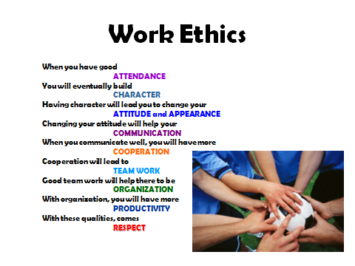
Decision No. 3 - Student Ethics

Slide 25

Decision No. 4 - Class Culture
Try to be one. Develop as one.
Specially, take decisions as one.
Strategically focused team

Slide 26
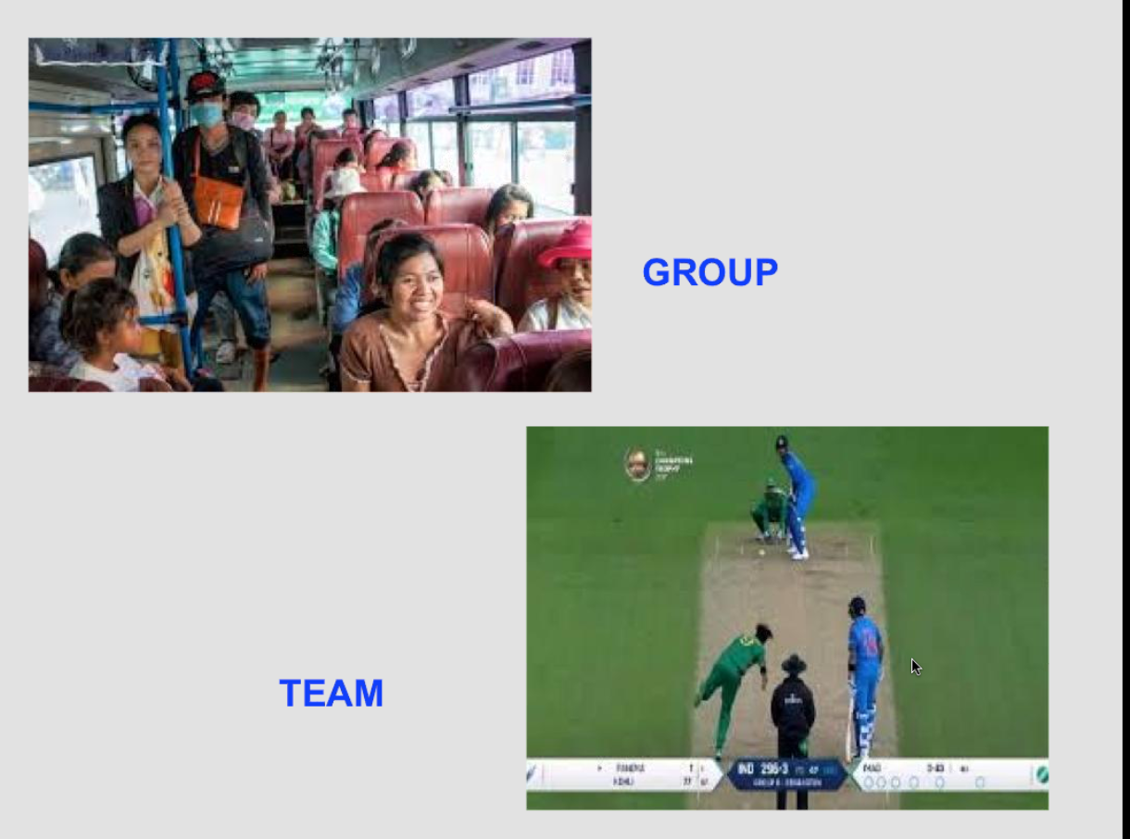
23MXians
?

Slide 27
Decision No 5 - Teachers
We are here to help you with everything
Learn from our experiences
Find a mentor for yourself
Remember the balance between friend and friendly

Slide 28
Know Our Alumni
Decision Number 6
Keep in touch with them.
Ask for guidelines.

Slide 29
Its not that you read Books / Notes Pass an Exam and Finish with Graduation The Whole of Life from the Moment you were born “ A Process of Life long Learning “
Decision Number 6-Cont’d

Slide 30
Career
You can get almost all types job from here
Programmer,
Software Engineering,
Network Infrastructure,
Website designer,
Ethical Hacker, Banks,
Any IT job,
Government Jobs………..

Slide 31
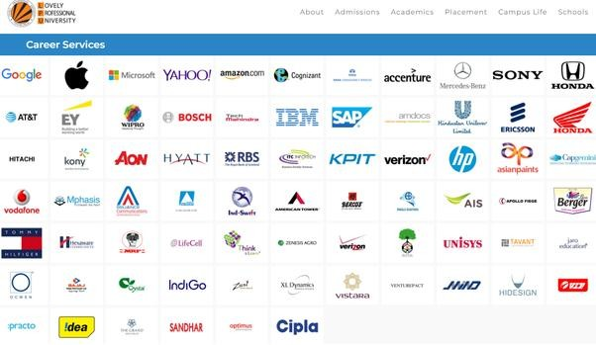
Big Shots

Slide 32


These doesn’T
come free

Slide 33
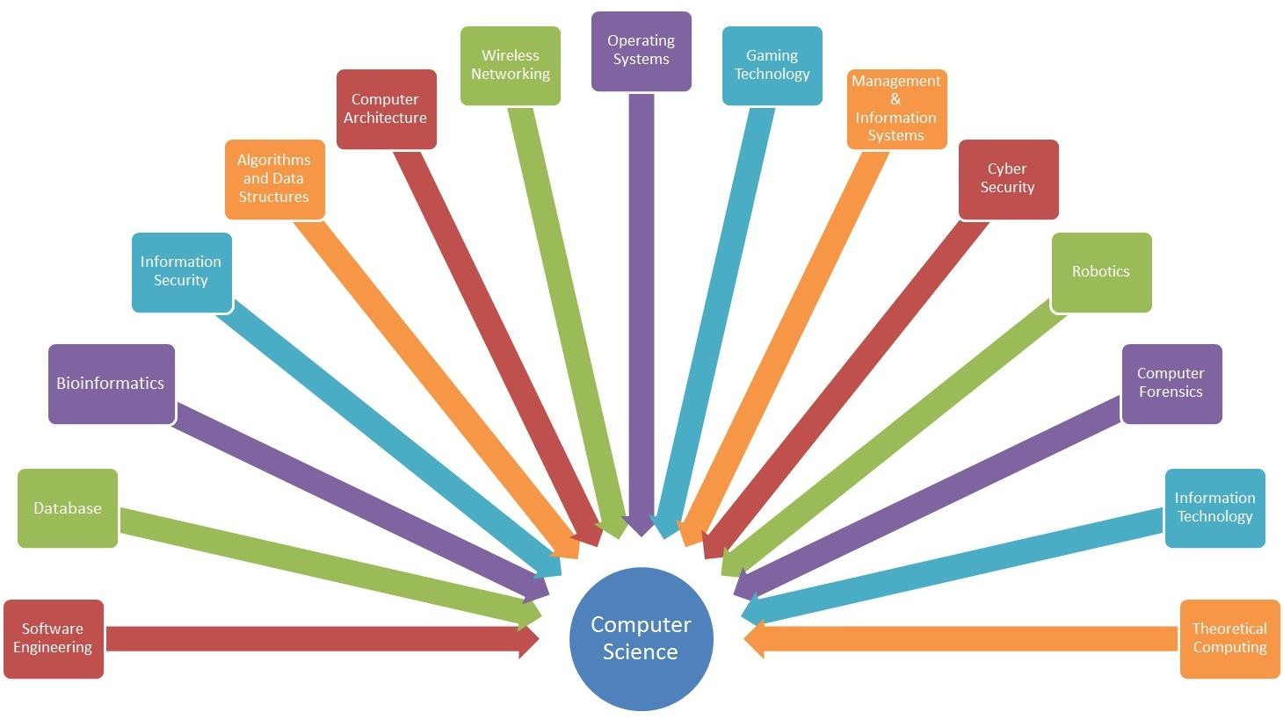

Slide 34


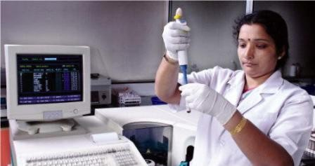
Give Equal Importance ALL Course Types
Theory
Lab

Slide 35
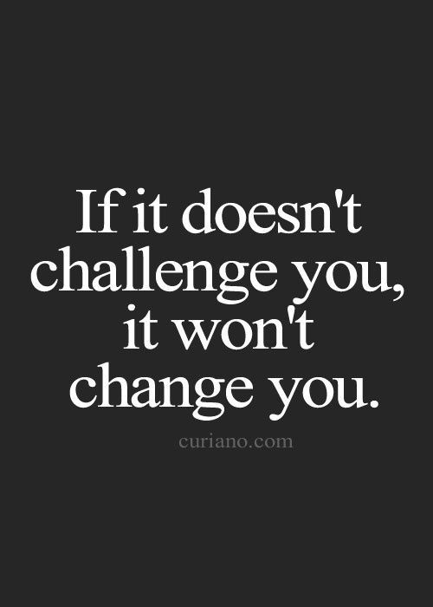
Decision No. 7

Slide 36
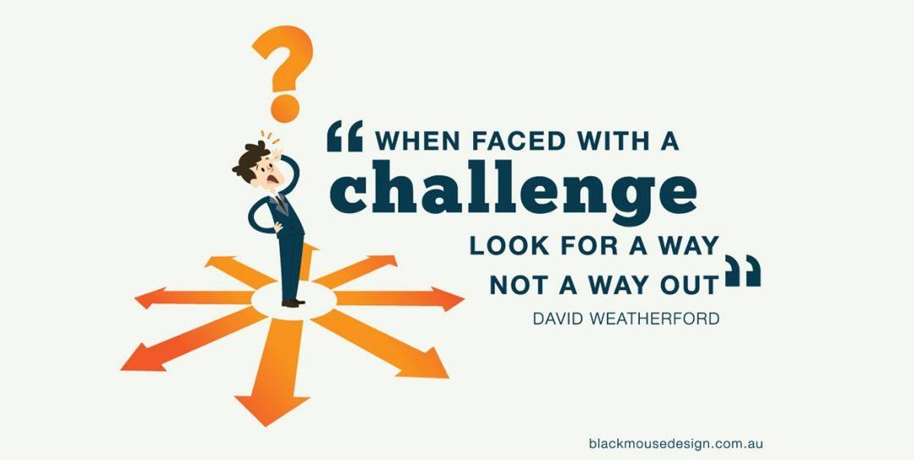
Challenges

Slide 37

Decision No. 8

Slide 38

Stackoverflow
Decision No. 8 Cont’d
Question Answering site
Point structure

Slide 39

Github
Code / Project sharing site
Collaboration
Version control

Slide 40

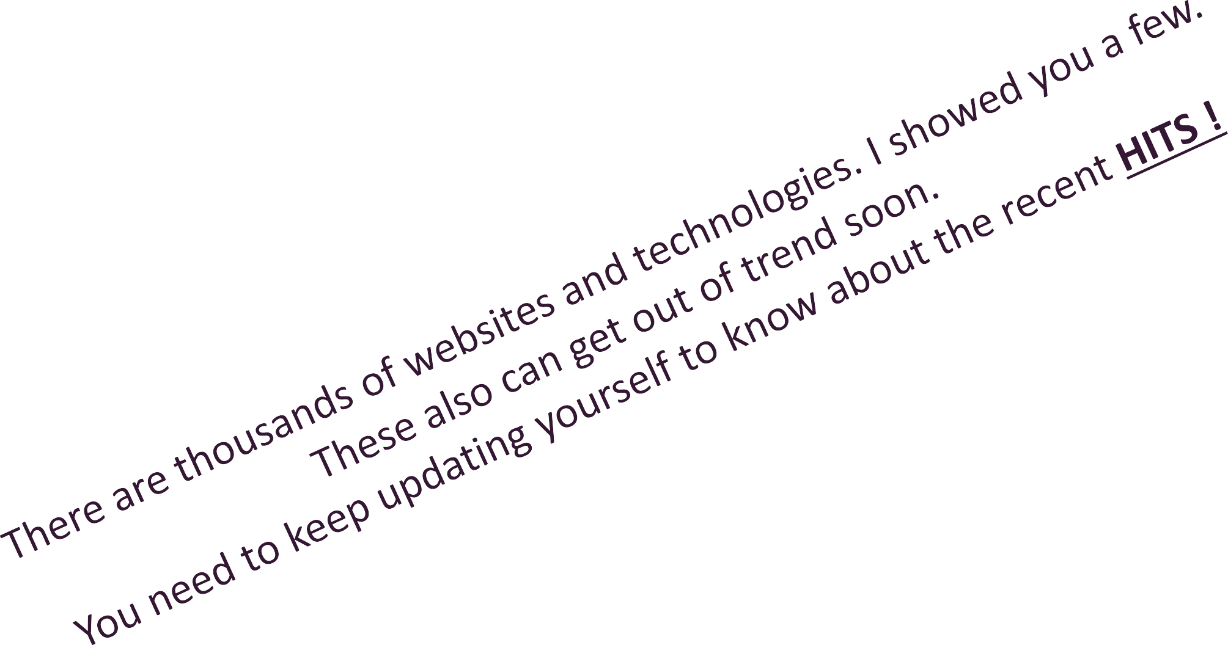
Few Websites to Get Started
https://stackoverflow.com/
https://github.com/
https://www.w3schools.com/
https://www.tutorialspoint.com/
https://www.codecademy.com/
https://onlinejudge.org/
https://www.codechef.com/

Slide 41


























Decision No. 9

Slide 42
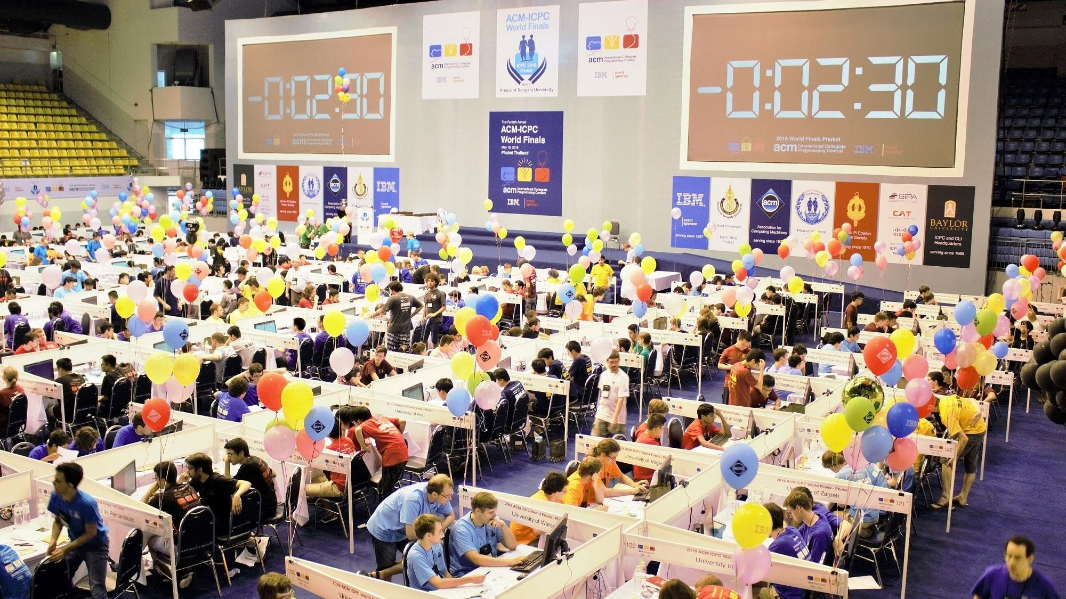

Slide 43
Test Everything You Learned and Record as CV
Decision No. 10

Slide 44
Create Projects on Your own Time – pet projects

Slide 45
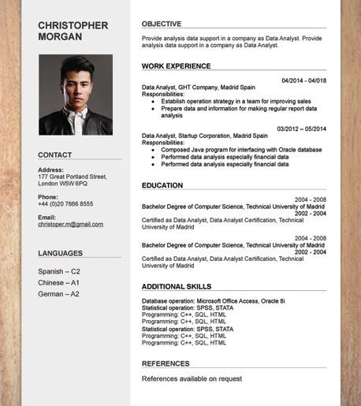
Create a CV from the beginning
Sounds strange, BUT Fact
Plan and Do stuff to fill your CV
This is the key, which will put you in front of other graduates

Slide 46

Sharing the knowledge will ultimately help you to learn properly. Final session with the group always helps to think about the unthinkable.

Slide 47
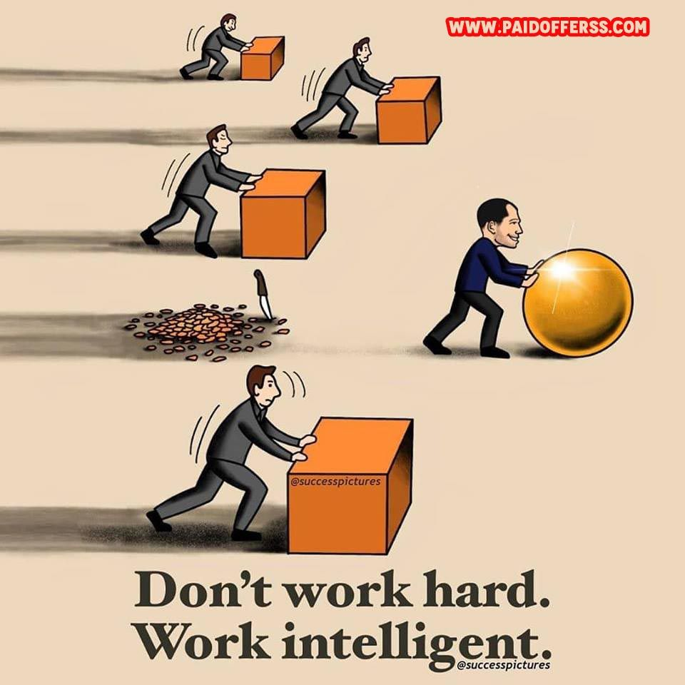

Slide 48


Slide 49


